Slide 1
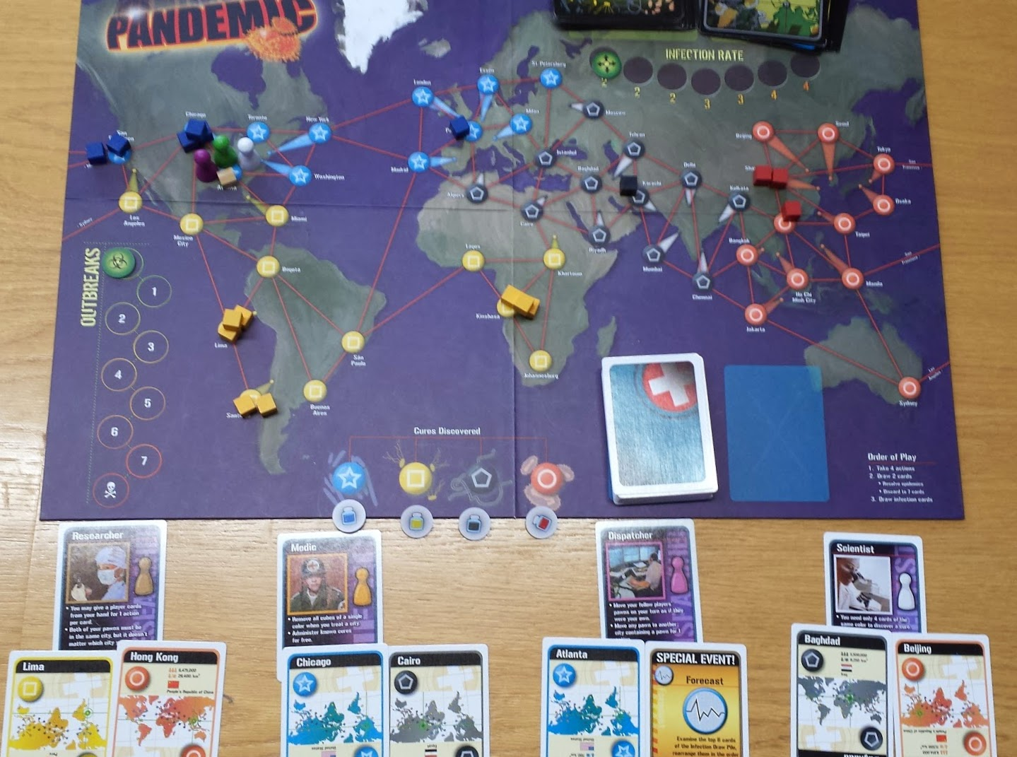
Start of Game

Slide 2
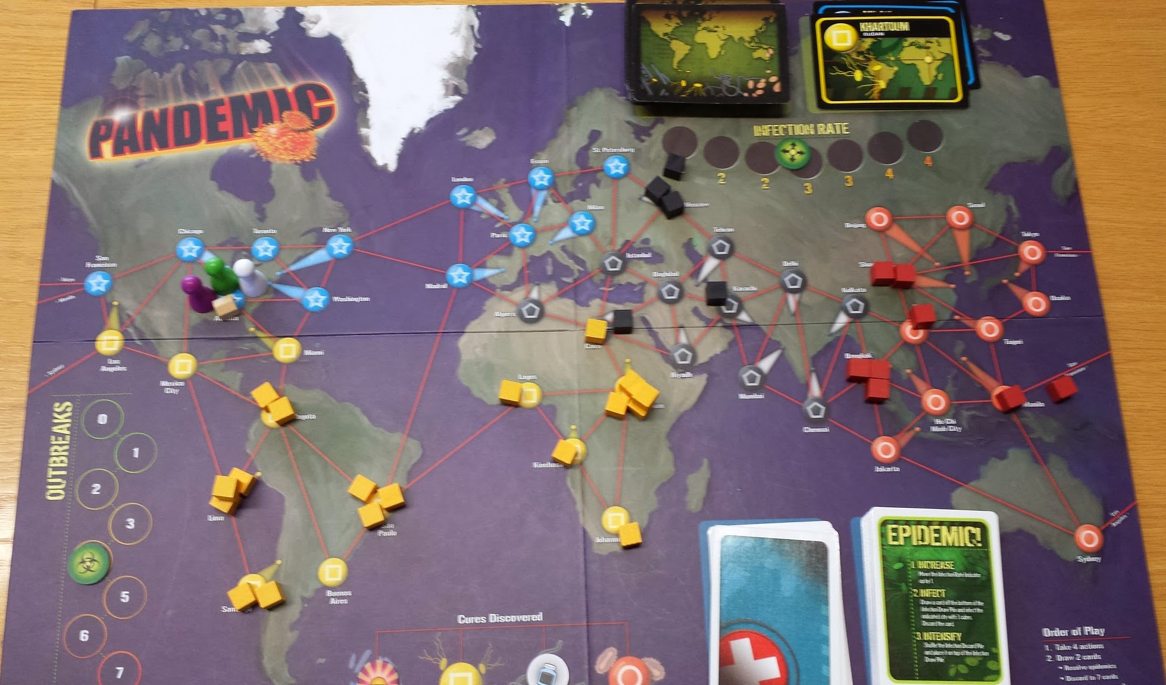
Mid-game display example

Slide 3
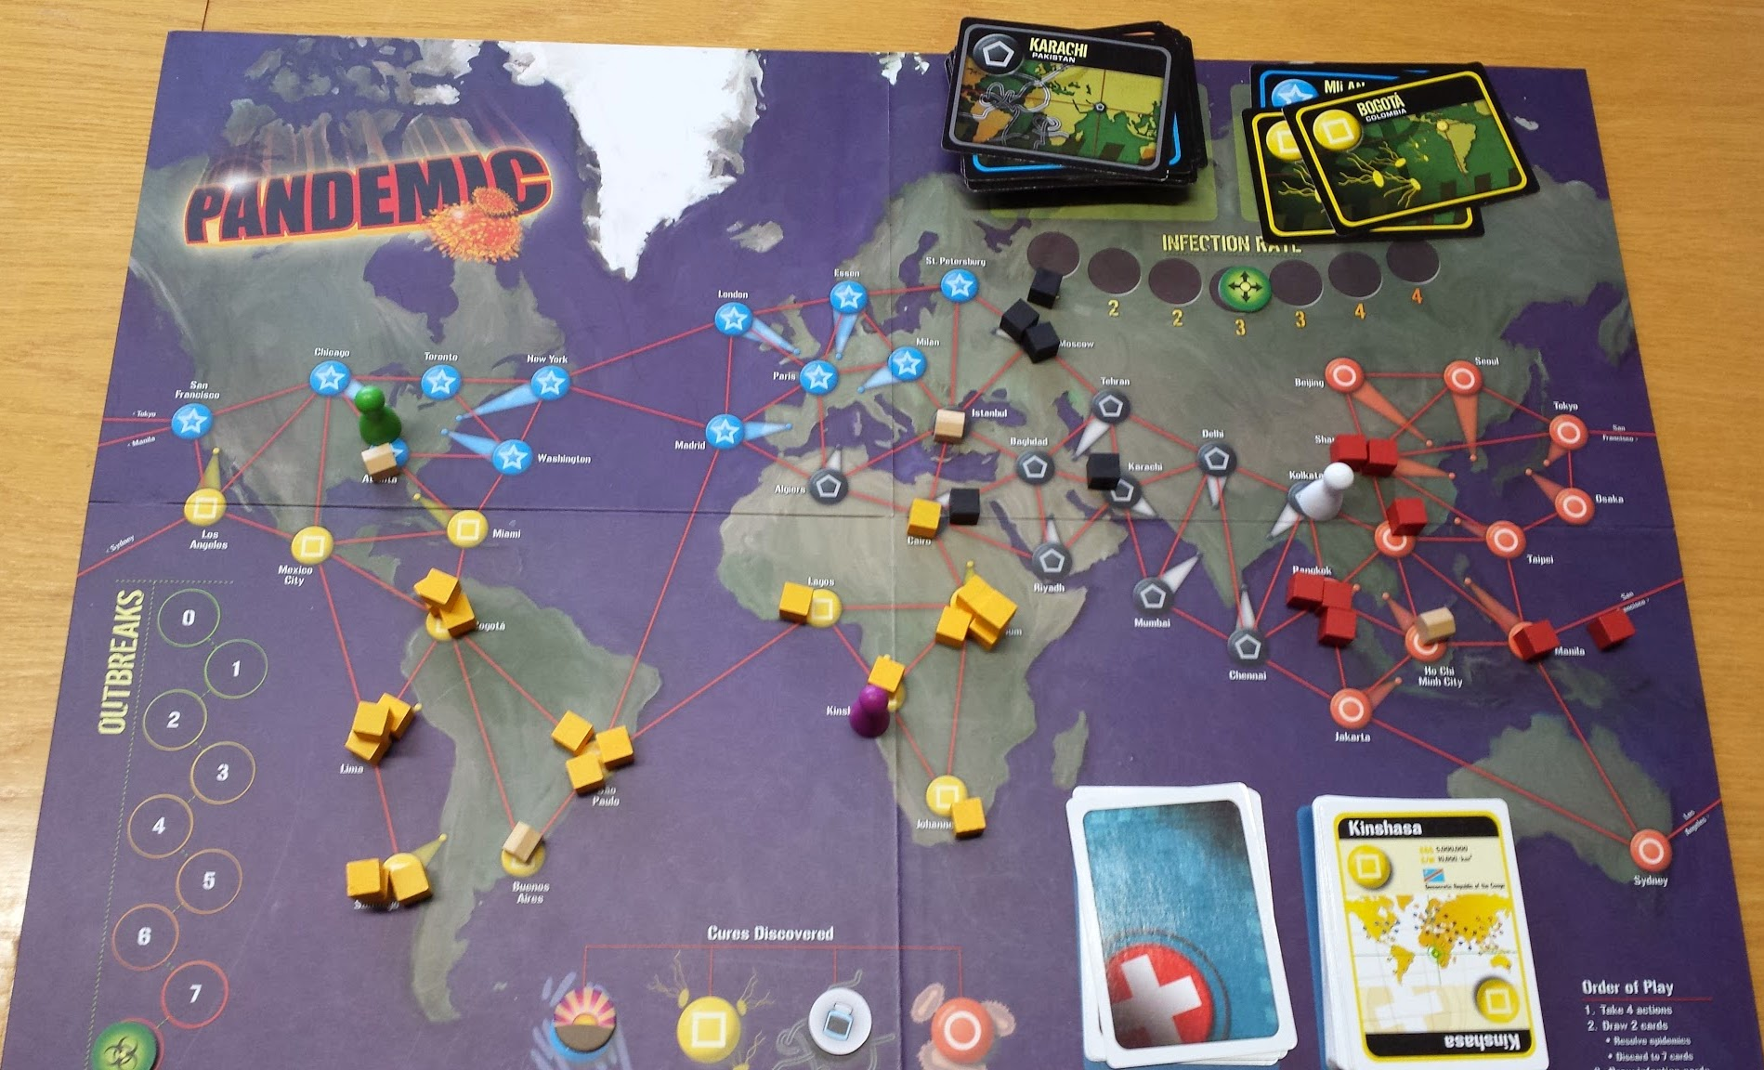
Mid-game display example (2)

Slide 4
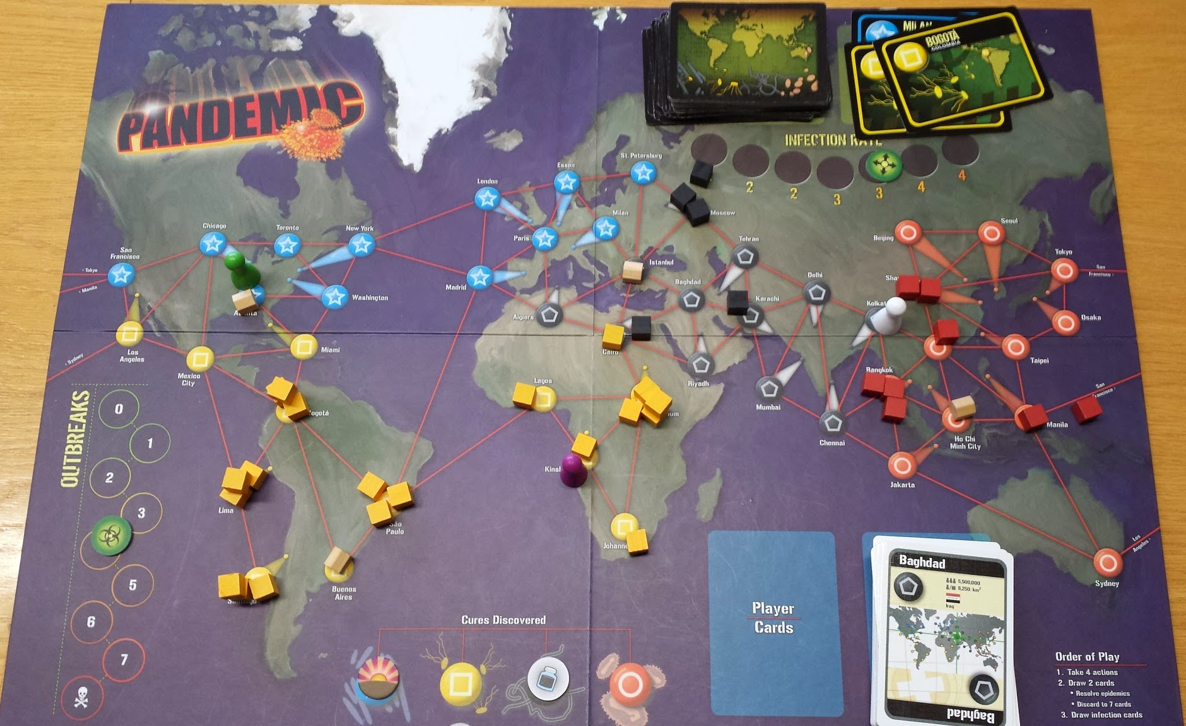
End-game display example

Slide 5
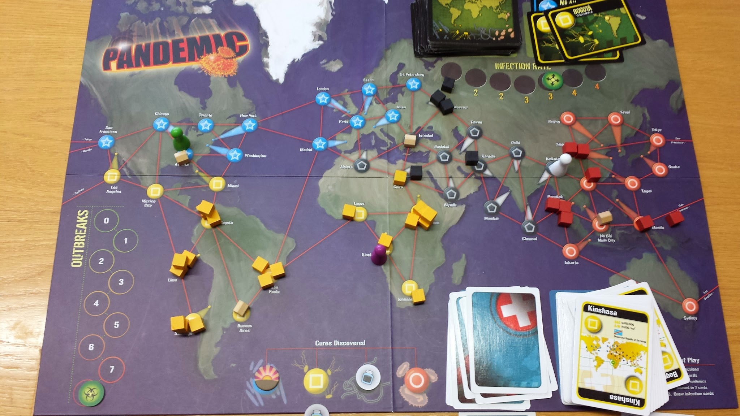
End-game display example (2)

Slide 6
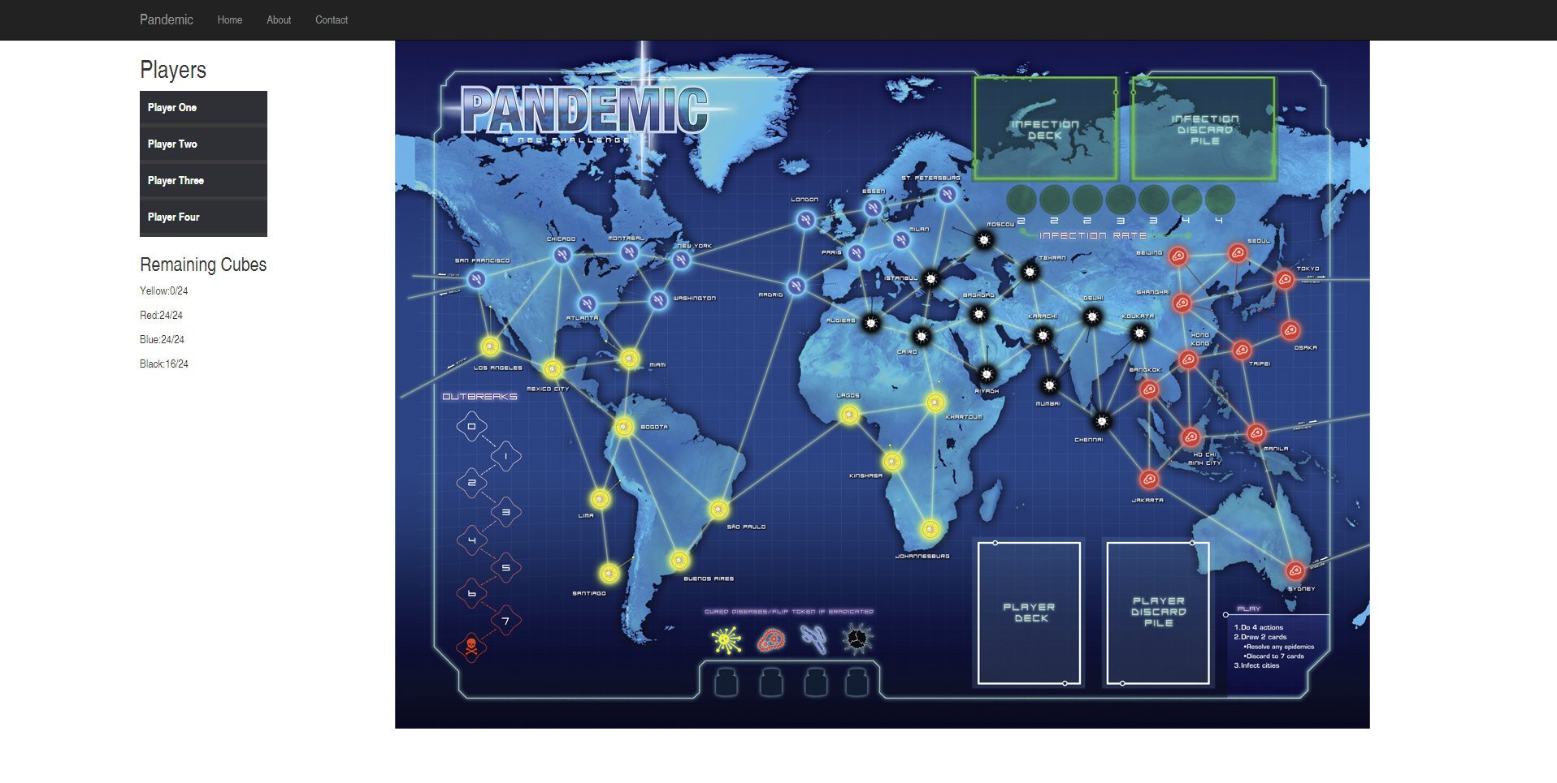
Current GUI Layout
Also, we can click on the players to view dropdowns.

